Slide 1





Smart Doorbell System Rakyan Satrya Adhikara 219548135

Slide 2

Problem Statements
Doorbells.. Can be used by everyone?
Modern doorbells, enough benefits?
Can be improved?

Slide 3
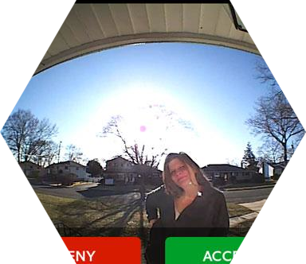
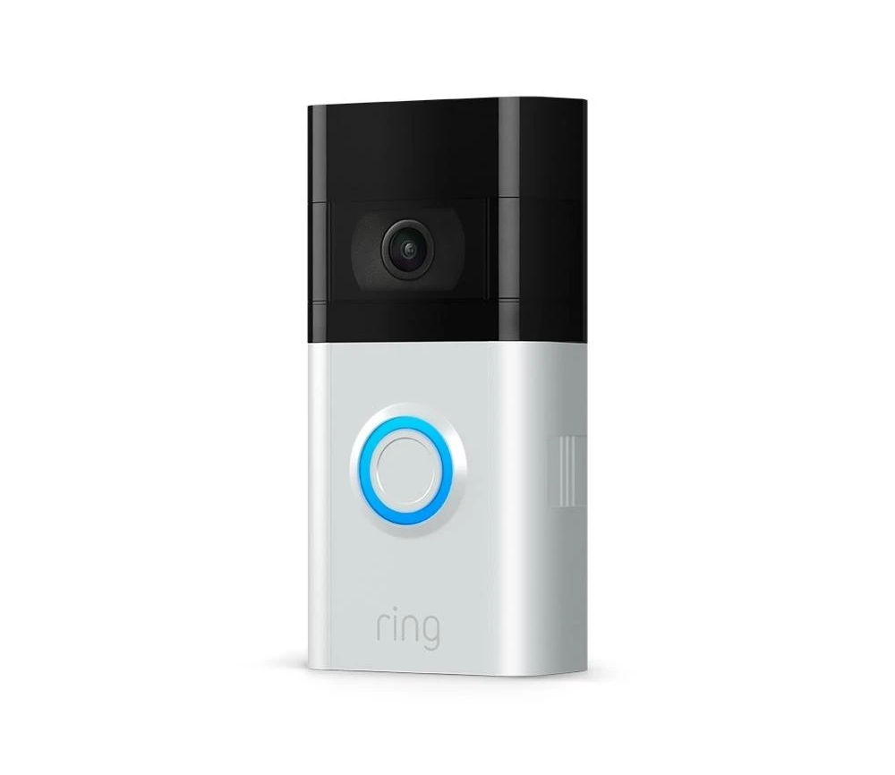
Available Options
Modern doorbells, that can do live feed
Everyone can use that?
Different product, different software required

Slide 4
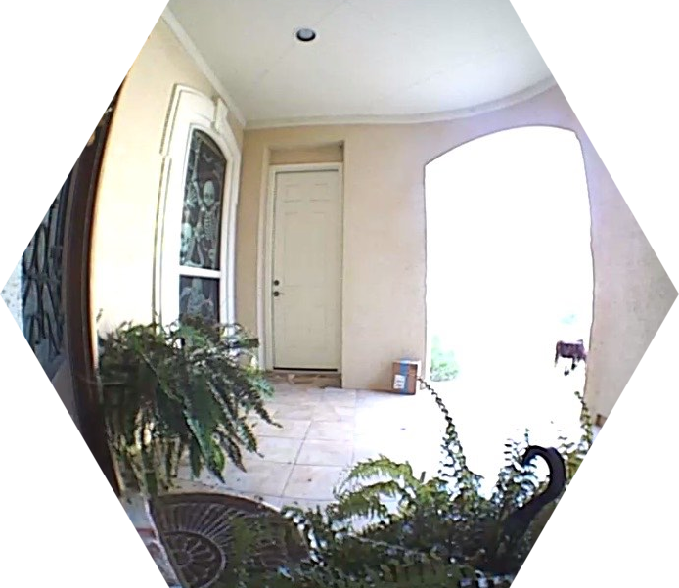
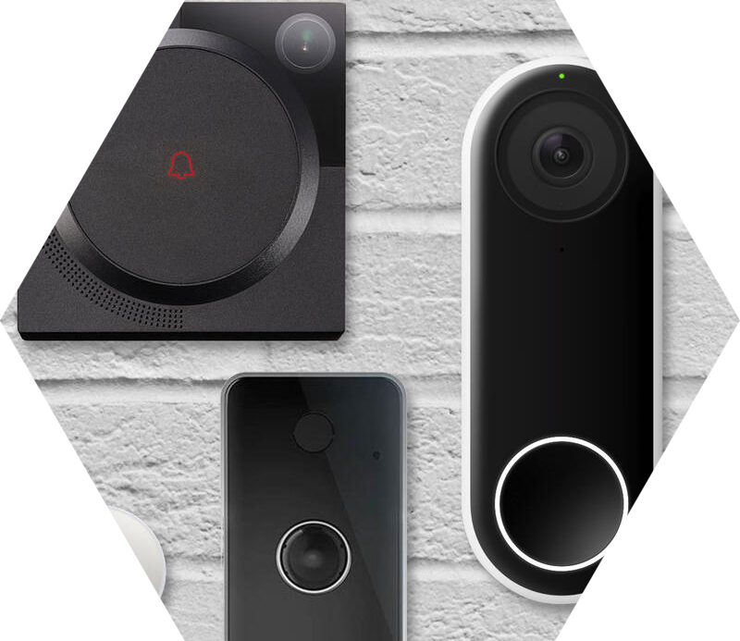
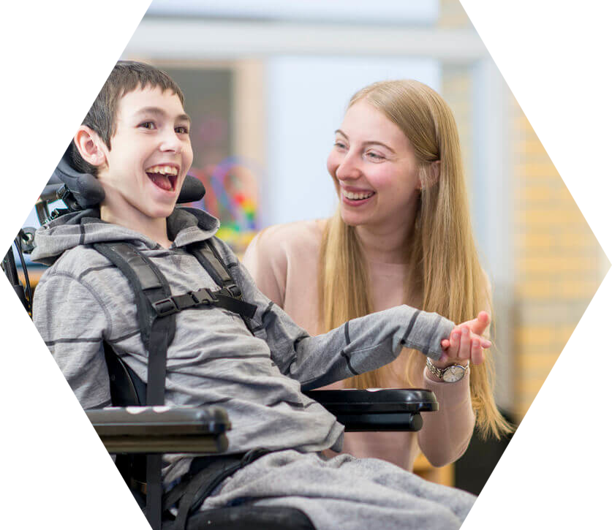
Aim of The Project
Modern doorbells, that can do live feed
Everyone can use that, even for people with disability
Only require email for accessing live feed

Slide 5
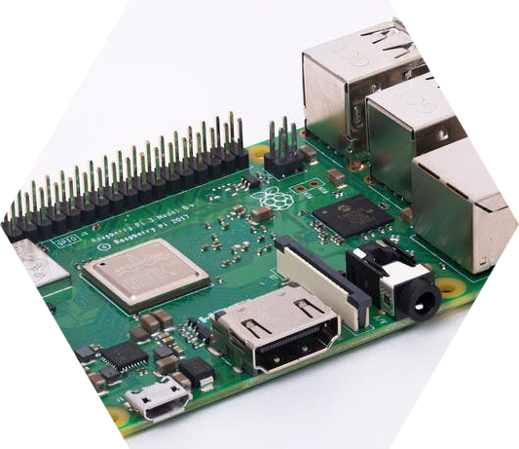
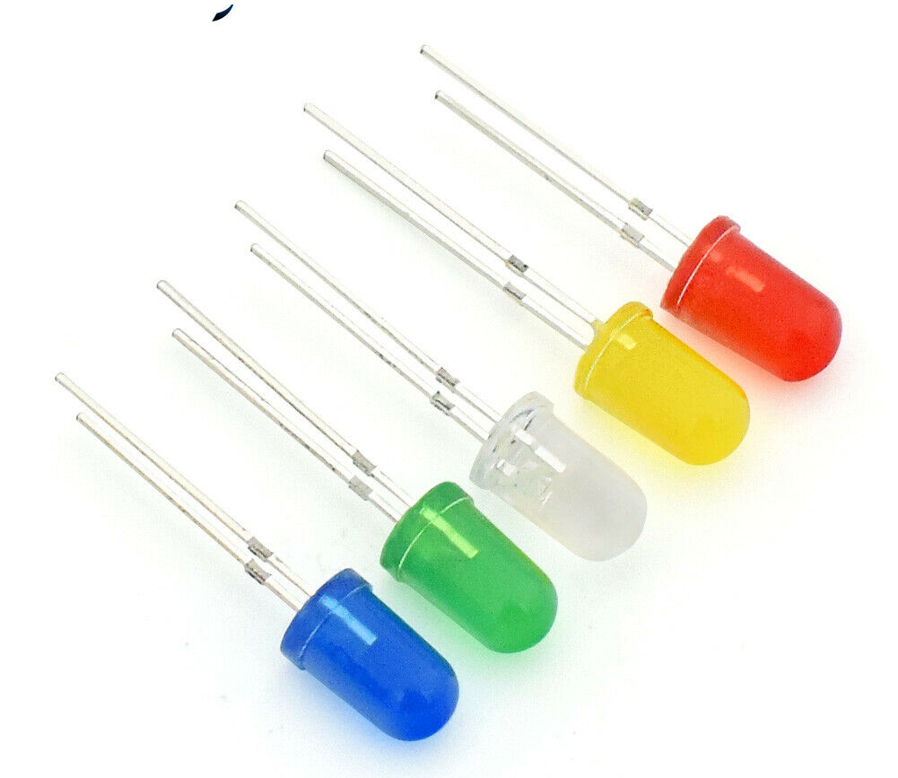
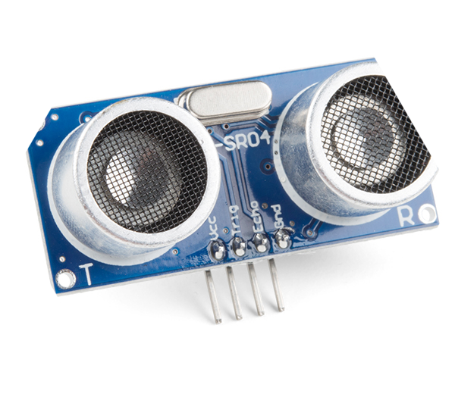
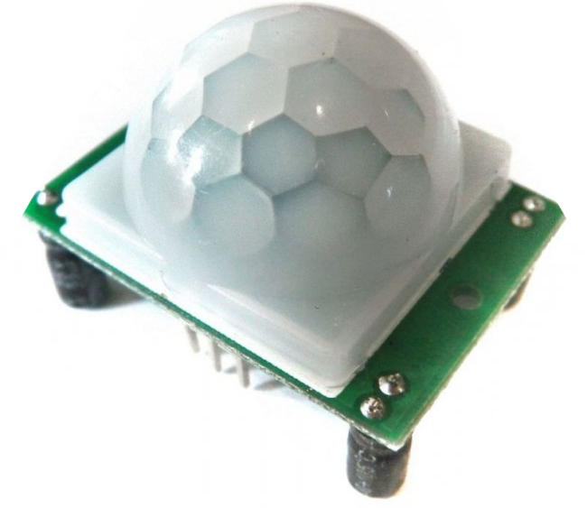
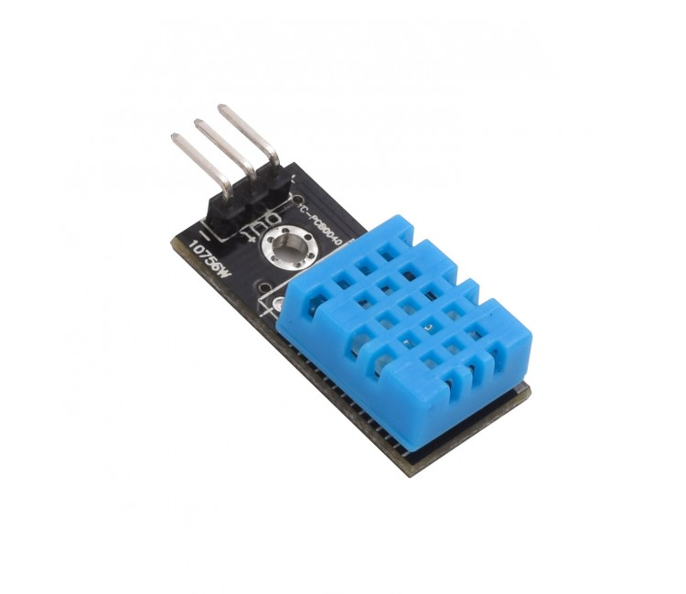
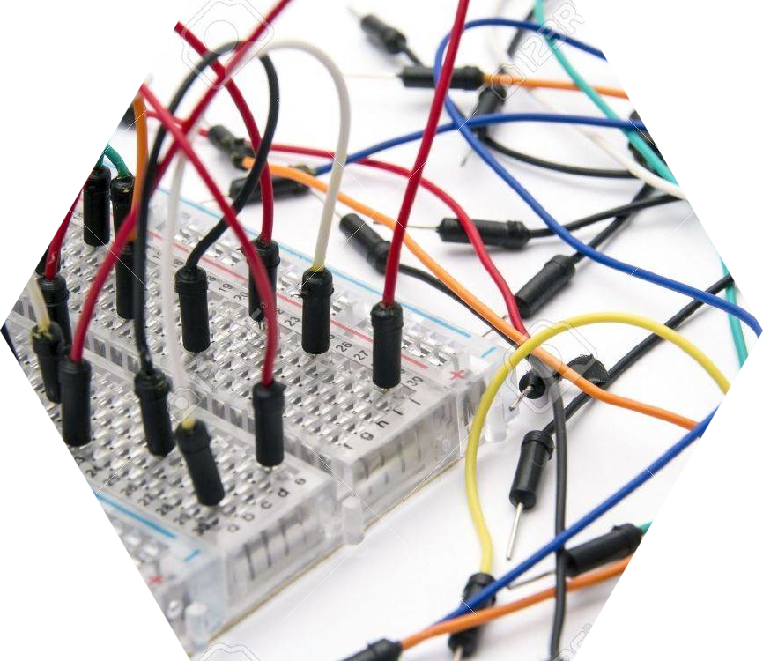
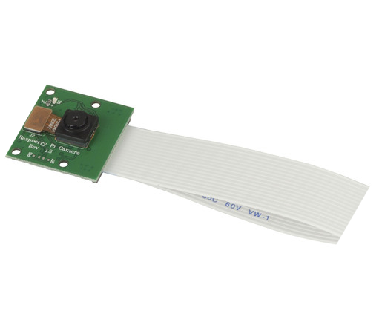
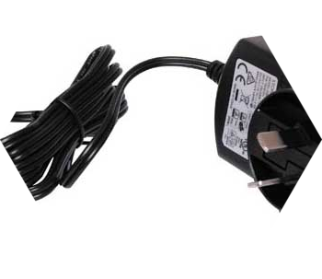
Requirements
Hardware:
Raspberry Pi 3B+
Ultrasonic Sensor (HC-SR04)
Temperature Sensor (DHT11)
PIR Infrared Sensor (HC-SR501)
5MP Camera for Raspberry Pi
LED Lights
Jumper Wires (M-F)
Jumper Wire (M-M)
Breadboard

Slide 6
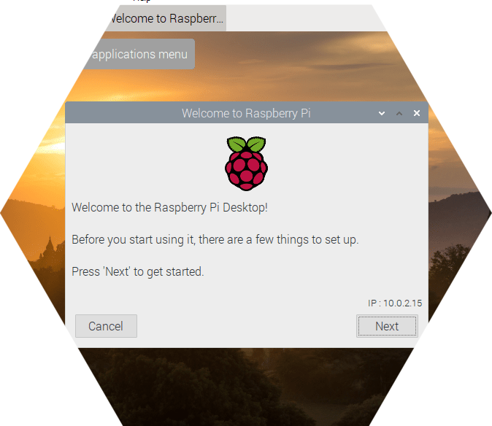

Requirements
Software:
Raspian
Python 3 IDE

Slide 7
Problem Solving
Every sensors (infrared, temperature, ultrasonic) detects person
If all sensors positive, green LED lighten up. Else, red LED lighten up
If all sensors positive, post email contains live feed video and/or photo

Slide 8
Drawbacks
There might be some chance that an animal can turn all the sensors to positive
Meaning, it might be send multiple of unnecessary emails

